Slide 1

CS 360 Programming Languages Day 10 - Motivation

Slide 2
Course Motivation
(Did you think I forgot? ☺)
Why learn languages that are quite different from Python or Java?
Why learn the fundamental concepts that appear in all (most?) languages?
Why focus on functional programming?

Slide 3
What is the best kind of car?
What is the best kind of shoes?

Slide 4
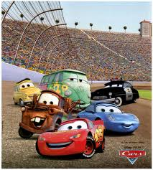
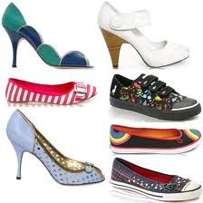
Cars / Shoes
Cars are used for rather different things:
Winning the Indy 500
Taking kids to soccer practice
Off-roading
Hauling a mattress
Getting the wind in your hair
Staying dry in the rain
Shoes:
Playing basketball
Going to a dance
Going to the beach

Slide 5
More on cars
A good mechanic might have a specialty, but also understands how “cars” (not 2023 Honda Civics) work.
And that the syntax---I mean upholstery color---isn’t essential
A good mechanical engineer really knows how cars work, how to get the most out of them, and how to design better ones.
To learn how cars work, it may make sense to start with a classic design rather than the latest model.
A popular car may not be a good car for learning how cars work.

Slide 6
All cars are the same
To make it easier for everyone to drive a car, it’s great that they all have common components, like steering wheels, brakes, windows, headlights, etc.
Yet it’s still uncomfortable to learn a new one.
And maybe PLs are more like cars, trucks, boats, and bikes.
So are all PLs really the same…

Slide 7
Are all languages the same?
Yes:
Any input-output behavior implementable in language X is implementable in language Y [Church-Turing thesis]
Python, Java, Racket, and a language with one loop and three infinitely-large integers are “the same”
Yes:
Same fundamentals reappear: variables, abstraction, recursive definitions, …
No:
The primitive/default in one language is awkward in another
Notes:
A Turing tarpit (or Turing tar-pit) is any programming language or computer interface that allows for flexibility in function but is difficult to learn and use because it offers little or no support for common tasks.^{[1]} The phrase was coined in 1982 by Alan Perlis in the Epigrams on Programming:^{[2]}
54. Beware of the Turing tar-pit in which everything is possible but nothing of interest is easy.

Slide 8
A note on reality
Reasonable questions when deciding to use/learn a language:
What libraries are available for reuse?
What can get me a summer internship?
What does my boss tell me to do?
What is the de facto industry standard?
What do I already know?
CS 360 by design does not deal with these questions.
You have the rest of your life for that.
And the answers will be different in a few years anyway.

Slide 9
Why semantics and idioms
This course focuses as much as it can on semantics and idioms.
Correct reasoning about programs, interfaces, and interpreters or compilers requires a precise knowledge of semantics.
Not “I think that conditional expressions might work like this.”
Not “I like curly braces more than parentheses.”
Much of software development is designing precise interfaces; what a PL means is a really good example.
Idioms make you a better programmer.
Best to see in multiple settings, including where they shine.
See future languages in a clearer light.

Slide 10

Hamlet
The play Hamlet (according to my English teacher):
Is a beautiful work of art.
Teaches deep, eternal truths.
Is the source of some well-known sayings.
Makes you a better person if you read it.
Continues to be studied (even in college) centuries later even though:
The syntax is really annoying to many (yet rhythmic).
There are more popular movies with some of the same lessons (just not done as well).
Reading Hamlet will not get you a summer internship.

Slide 11
Functional Programming
Okay, so why do we spend so much time with functional languages, i.e., languages where:
Mutation is unavailable or discouraged
Recursion expresses all forms of looping and iteration
Higher-order functions are very convenient
Because:
These features are invaluable for correct, elegant, efficient software (great way to think about computation)
Functional languages have always been ahead of their time
Functional languages well-suited to where computing is going
Most of course is on (1), so a few minutes on (2) and (3) …

Slide 12
Ahead of their time
All of these were dismissed as “beautiful, worthless, slow things PL professors make you learn in school”
Garbage collection (now used in Python, Java, and most modern languages other than C/C++)
Collections (i.e., lists) that can hold multiple data types at once (Python, Java via generics, C++ through templates)
Higher-order functions (Python, Ruby, JavaScript, more recent versions of C++, …)
Recursion (a big fight in 1960 about this – I’m told ☺)

Slide 13

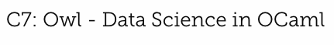
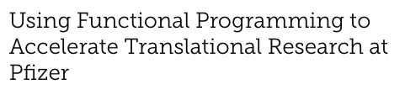
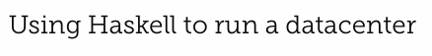
Recent Surge

Slide 14
Why a recent surge in functional programming?
My best guesses:
Concise, elegant, productive programming.
JavaScript, Python, Ruby helped break the Java/C/C++ hegemony.
And these functional languages do some things better.
Avoiding mutation is the easiest way to make concurrent and parallel programming easier.
Sure, functional programming is still a small niche, but there is so much software in the world today even niches have room.

Slide 15
Is this real programming?
The way we're using Racket in this class can make the language seem almost “silly” precisely because lecture and homework focus on interesting language constructs.
“Real” programming needs file I/O, string operations, graphics, fancy IDEs, testing frameworks, threads, build systems, …
Functional languages have all that and more.
If we used Java or Python the same way, those languages would seem “silly” too.

Slide 16
The languages together
Why these languages?
dynamically typed statically typed
functional Racket
object-oriented Python Java
ML: polymorphic types, pattern-matching, abstract types & modules
Racket: dynamic typing, “good” macros, minimalist syntax, eval
Ruby: classes but not types, very OOP, mixins
[and much more]
Really wish we had more time:
Haskell: laziness, purity, type classes, monads
Prolog: unification and backtracking
[and much more]

Slide 17
Summary
No such thing as a “best” PL.
There are good general design principles for PLs.
A good language is a relevant, crisp interface for writing software.
Software leaders should know PL semantics and idioms.
Learning PLs is not about syntactic tricks for small programs.
Functional languages have been on the leading edge for decades
Ideas get absorbed by the mainstream, but very slowly.
Meanwhile, use the ideas to be a better programmer in Java and Python.

